Slide 1


nenekara
te reO APP
COCKS | KERSCHBAUMER | NELLAS
CLIENT: ERUERA RUWHIU
SUPERVISED BY: KEVIN SHEDLOCK
Notes:
Kia ora and Welcome everyone
I’m Marina and this is Patricia and this Jayson.
We’re going to be presenting the work we’ve been doing this semester on a Te Reo App we’ve been creating for Whitireia’s Wānanga Māori.

Slide 2

THE TEAM
Client: Eruera Ruwhiu, Te Wānanga Māori
Supervisor: Kevin Shedlock
Development Team:
Patricia Nellas
Jayson Cocks
Marina Kerschbaumer
Notes:
I’ll be starting with some background information.
First off all the people on the project team:
Our client is Eruera Ruwhiu or Eru, who one of the wānagna’s language tutors.
Our supervisor was Kevin Shedlock, one of the school of IT’s tutors.
The development team you’ve already met: Jayson, Patricia and myself are all third year Bachelor of IT students.

Slide 3
BACKGROUND
Te Reo at Whitireia Polytechnic
Offers beginner courses and a National Diploma in Reo Māori
Teaches traditional Māori first – colloquial expressions come later
Learning resources: online and hardcopy dictionaries, textbooks, handouts and CDs.
Notes:
Next up I’ll give some background on learning Te Reo at Whitireia.
The department teaches courses ranging from part-time beginners courses and to a more advanced, full immersion programs that get students proficient in traditional reo and tikanga.
The resources student have to help in learning:
Online and hard dictionaries
Textbooks
CDs
While these are all useful and valuable in their own right, they do have limitations:
they lack interactivity and portability

Slide 4
BACKGROUND
The Problem
Difference between Ehara and Kahore
Practicing sentence structures in general
Notes:
This bring us to the problem presented to the team.
At our first meeting Eru explained that there is consistently a problem trying to teach students when to use the words Ehara and Kahore.
Both Ehara and Kahore are used in Māori to express negative statements, however they are not interchangeable. (Similar to, but not the same as, “no” and “not” in English)
This is further complicated by the fact that ehara can also mean “For sure!” in colloquial Māori.
Our challenge was to come up with technology based a solution that helps students practise using both Ehara and Kahore in negative sentences.
As an extension of this, we decided it would make sense to create a solution that could be applied to any sentence structure, so the application could be expanded to suit other learning needs.

Slide 5
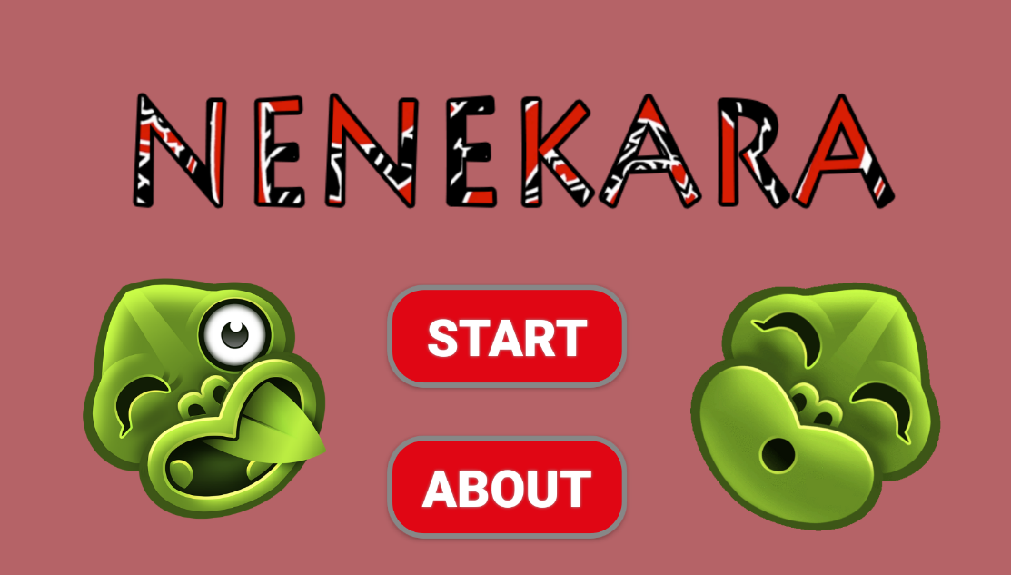
BACKGROUND
The Solution
Nenekara – a phone-based application that students can practice Ehara and Kahore when and where they have time.
Notes:
Our propsed solution was a sentence scramble Android application called Nenekara (nonsense).
The rest of our presentation walks through:
the process we went through to create the prototype
the tools we used
problems we encountered and what we did to overcome them.

Slide 6

OBJECTIVE
To provide a means for users to improve their learning of Te Reo sentence structures with a mobile application.

Slide 7
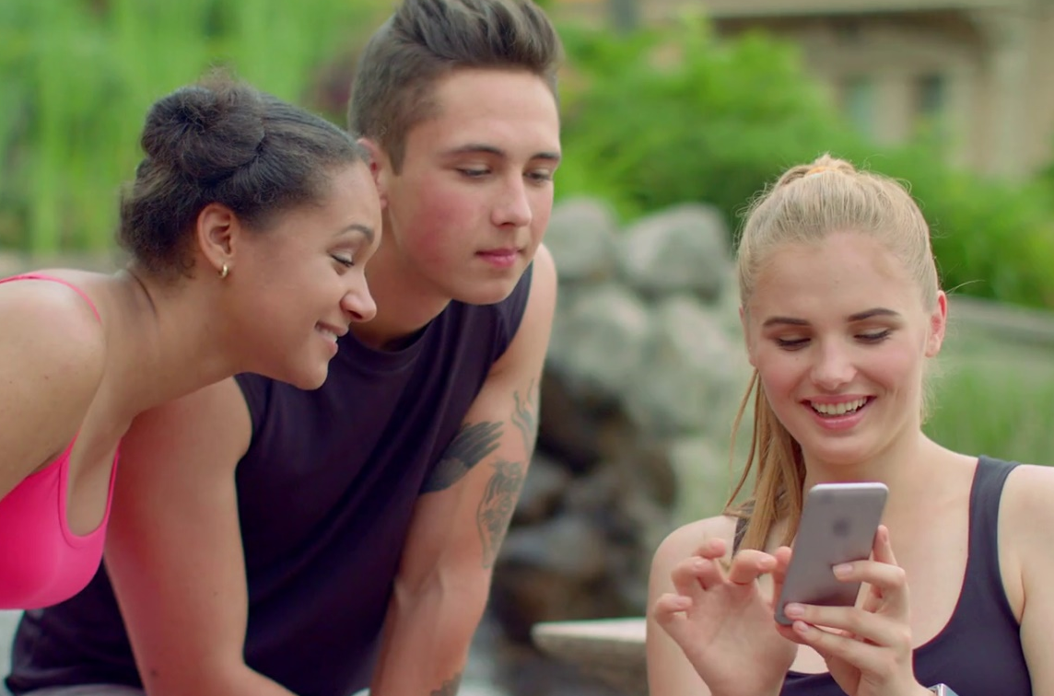
END-USERS
Students from Whitireia’s Te Reo school, aged 18 and up, and competent with smart phones

Slide 8
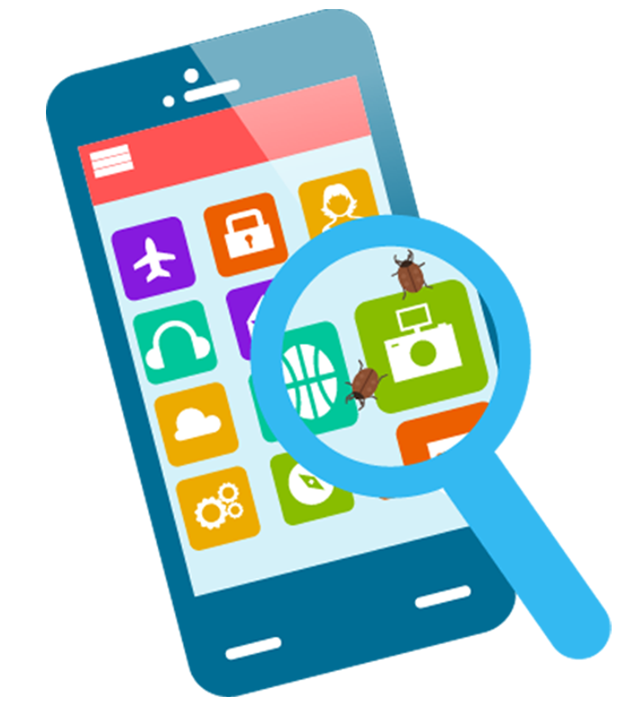
SCOPE
We have created a working prototype of an Android application that focuses on the use of ehara and kahore.

Slide 9
SCOPE
We created a database which contained three sentences that uses either ehara or kahore, the corresponding question to that particular sentence, and the ‘red herring’ word.

Slide 10
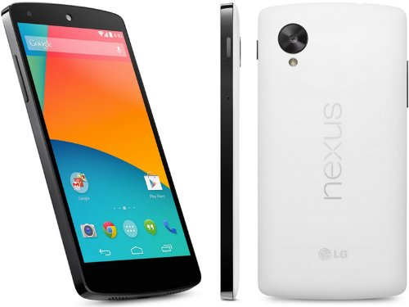
SCOPE
At this stage, the application was designed for the Nexus 5 smartphone with Android version 6.0.1.

Slide 11

SCOPE
The application was designed so different sentence structures can be added in future iterations.

Slide 12
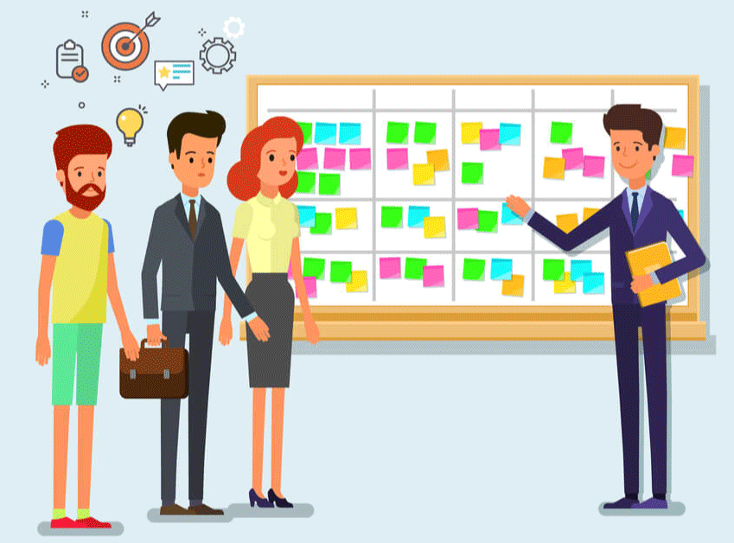
SCOPE
This project used the RAD methodology with Kanban.
Notes:
Talk about how the project is split into iterations. DO NOT talk about the RAD cycle. Give a brief intro on RAD.

Slide 13
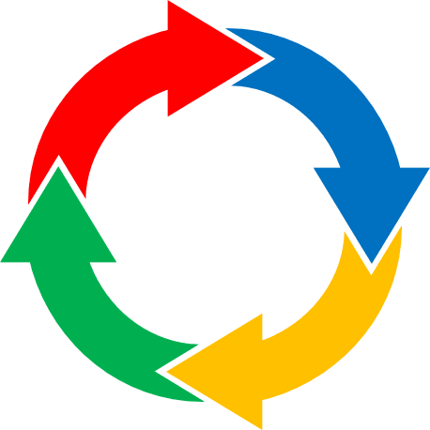
SCOPE
Each RAD prototyping cycle included:
UI Development
Database Development
Backend Programming
Functionality Testing
Client Feedback

Slide 14


technology
Android Studio
main development environment
allows for dragging and dropping UI components
receives official updates from Android

Slide 15
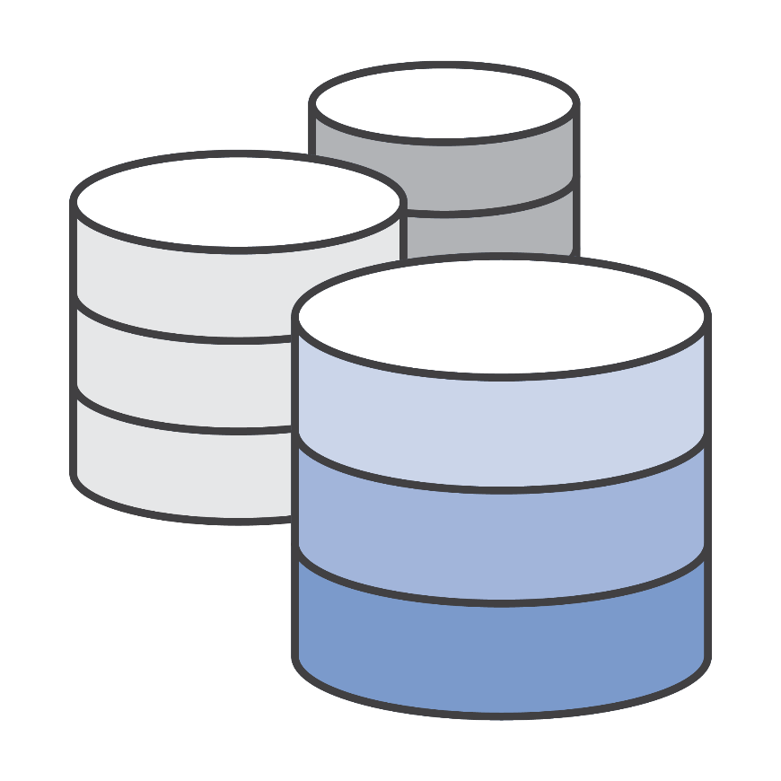
technology
SQLite
open-sourced, lightweight, and a standalone database.
served as the embedded database for our application.

Slide 16
technology
DBBrowser for SQLite
used to view and manage the data in the SQLite database.

Slide 17

technology
GitLab
was used for repository and backup purposes
served as a collaboration tool for the backend development

Slide 18

technology
Hardware
HP laptops (EliteBook 8560p)
LG Nexus 5 smartphones running Android version 6.0.1

Slide 19




Communication plan
Google drive
Facebook messenger
Slack
Kanban
Meetings
Email
Notes:
Google drive
store documentation
chosen because it’s the cloud storage we were all familiar with
Facebook messenger
everyday communication between the dev team
Allowed for group chat
We all already used it so there was no learning needed.
Slack
Could have been very powerful for collaboration
Because Messenger met most our needs, we only really used it for sharing code snippets with each other.
Frankly between Android Studio and GitLab we had enough new software to familiarise ourselves with.
Kanban Flow
Planned on using KanbanFlow to manage workflow.
KanbanFlow is a web-based Kanban board.
It’s easy to use
Met all of our requirements
It feel into disuse after about two weeks because we used our study area an lot and it was more practical to use a physical Kanban board – it was easier to update and didn’t require an extra browser window.
It addition to the above tools we had team meetings, supervisor meetings and client meetings.
Communicated with our supervisor by email.

Slide 20
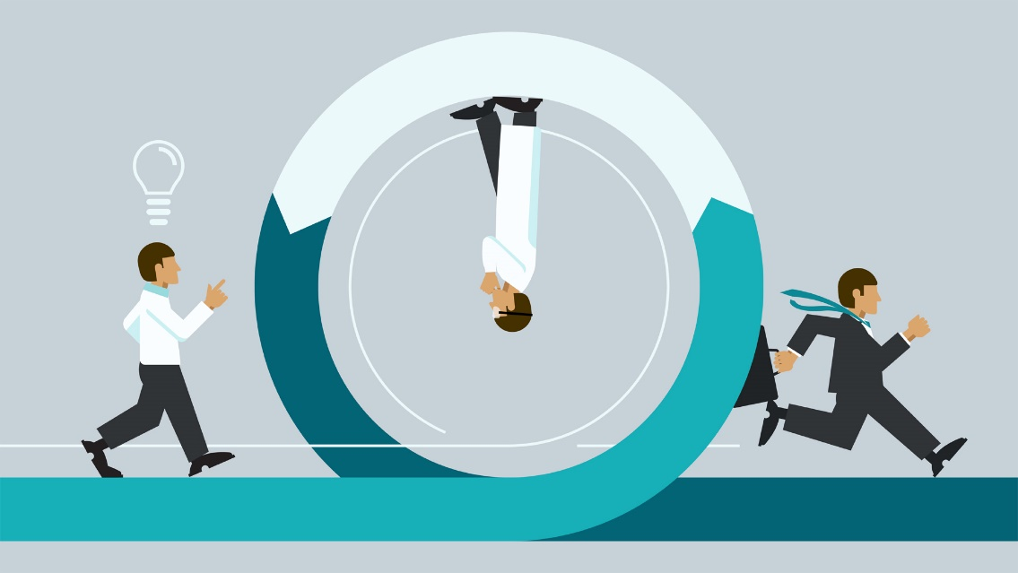
METHODOLOGY
RAD (Rapid Application Development)
It is a form of Agile software development methodology.

Slide 21
METHODOLOGY
RAD (Rapid Application Development)
It emphasizes on working software and feedback over strict planning and requirements recording.

Slide 22
METHODOLOGY
Demonstrate
Initial Requirements
Prototype
Cycle
Testing
Deployment
Develop
Refine
RAD (Rapid Application Development)

Slide 23
PROJECT PLAN
Iteration | Task Name | Deliverables
1 | Requirements Analysis and Setup | Wireframes Program Classes Database Design
 | Basic Prototyping Upskill in Android Studio and SQLite Setup development environment Design program classes
Notes:
Iteration one was focused very much on project requirements and setup:
Prior to our initial meeting with the client.
all we knew about the project
Sentence Sturcture
Android
That was enough preparation
When it came time to have that meeting we were able to elicit enough of the requirements to get straight into prototyping.
Established the focus of ehara/kahore for our project.
After the initial meeting:
brainstorming as a development team
researched some existing applications.
Most importantly did some paper prototyping.

Slide 24
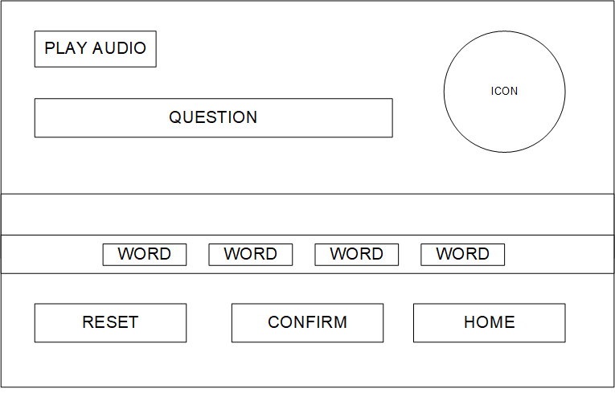
PROJECT PLAN
Notes:
Following on the feedback we received from our client regarding the paper prototypes we firmed up the interface design and decided to do a sentence scramble application that would:
1. Present the user with a question
2. Present the answer to the question in a scrambled up format.
3. Require the user to unscramble the question using drag and drop.
4. Play audio and display related images.
From there, design and document:
the wireframes
the database
the program classes.
At the same time:
Setting up development environment and familiarising ourselves with Android Studio, SQLite and Gitlab.
As we’ve already mentioned, each of these pieces of software came with quirks that meant this wasn’t a straight forward process.

Slide 25
PROJECT PLAN
Iteration | Task Name | Deliverables
2, 3, 4, and 5 | Prototyping Cycle | Android Application Test Plans
 | Develop UI Develop Database Develop backend code Black Box Testing User feedback Reassess requirements
Notes:
Refining for each prototyping cycle

Slide 26
PROJECT PLAN
Feedback
CYCLE 1: Usability Issues
CYCLE 2: Lack of guides and popup messages
CYCLE 3: Interface Issue (Placement of buttons)
CYCLE 4: Client was satisfied with the work to date
Notes:
Refining for each prototyping cycle

Slide 27
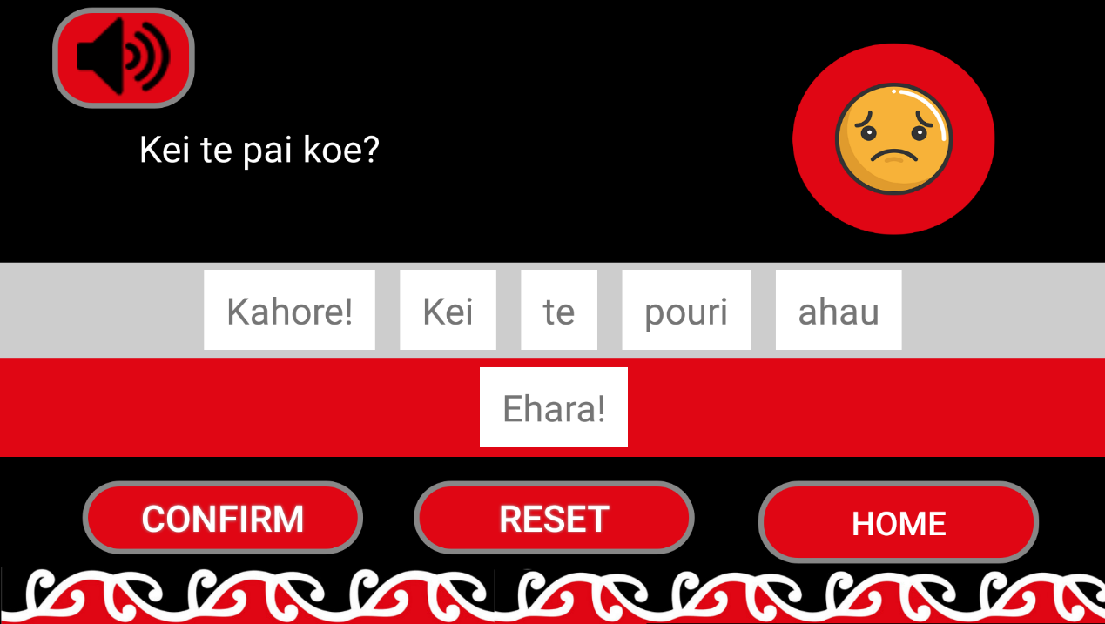
PROJECT PLAN
QUESTION
AUDIO
DRAG and DROP your answer to the top.
Notes:
Refining for each prototyping cycle

Slide 28
PROJECT PLAN
Iteration | Task Name | Deliverables
6 | Finalise Project/Deployment | Android Application Handover Documentation
 | Finalise application Finalise documentation

Slide 29
CONCLUSION
Our Android application has met specifications and client is pleased with the end product.
The main issues we overcame were familiarising ourselves with Android studio and implementing the SQLite database.
The foundation has been set for next team to continue on from with a thorough list of features to work on.

Slide 30
The END

